Slide 1


Computer Applications to Behavioral Sciences
Lecture 2. Variable, Expression & Statement
何吉波，博士
清华大学用户体验学科负责人
优视眼动科技公司创始人
http://www.usee.tech

Slide 2
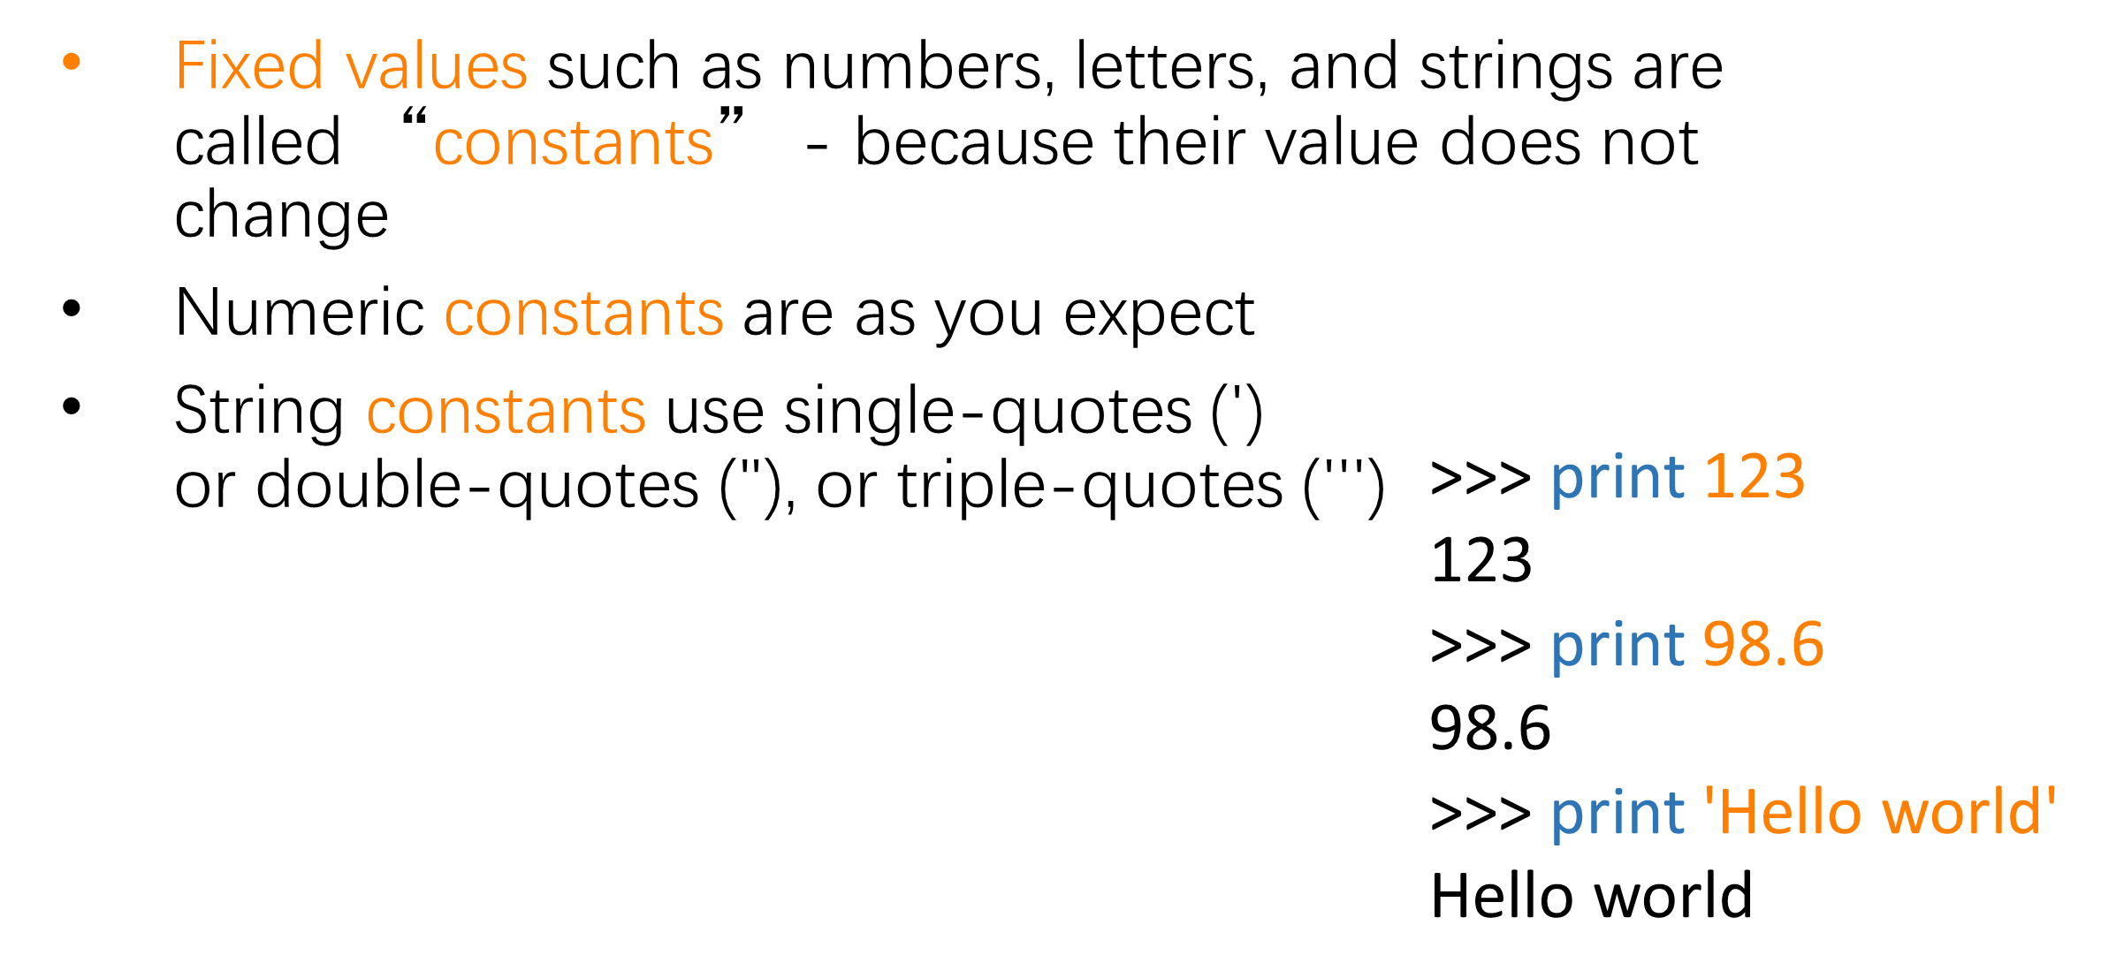
Constants

Slide 3
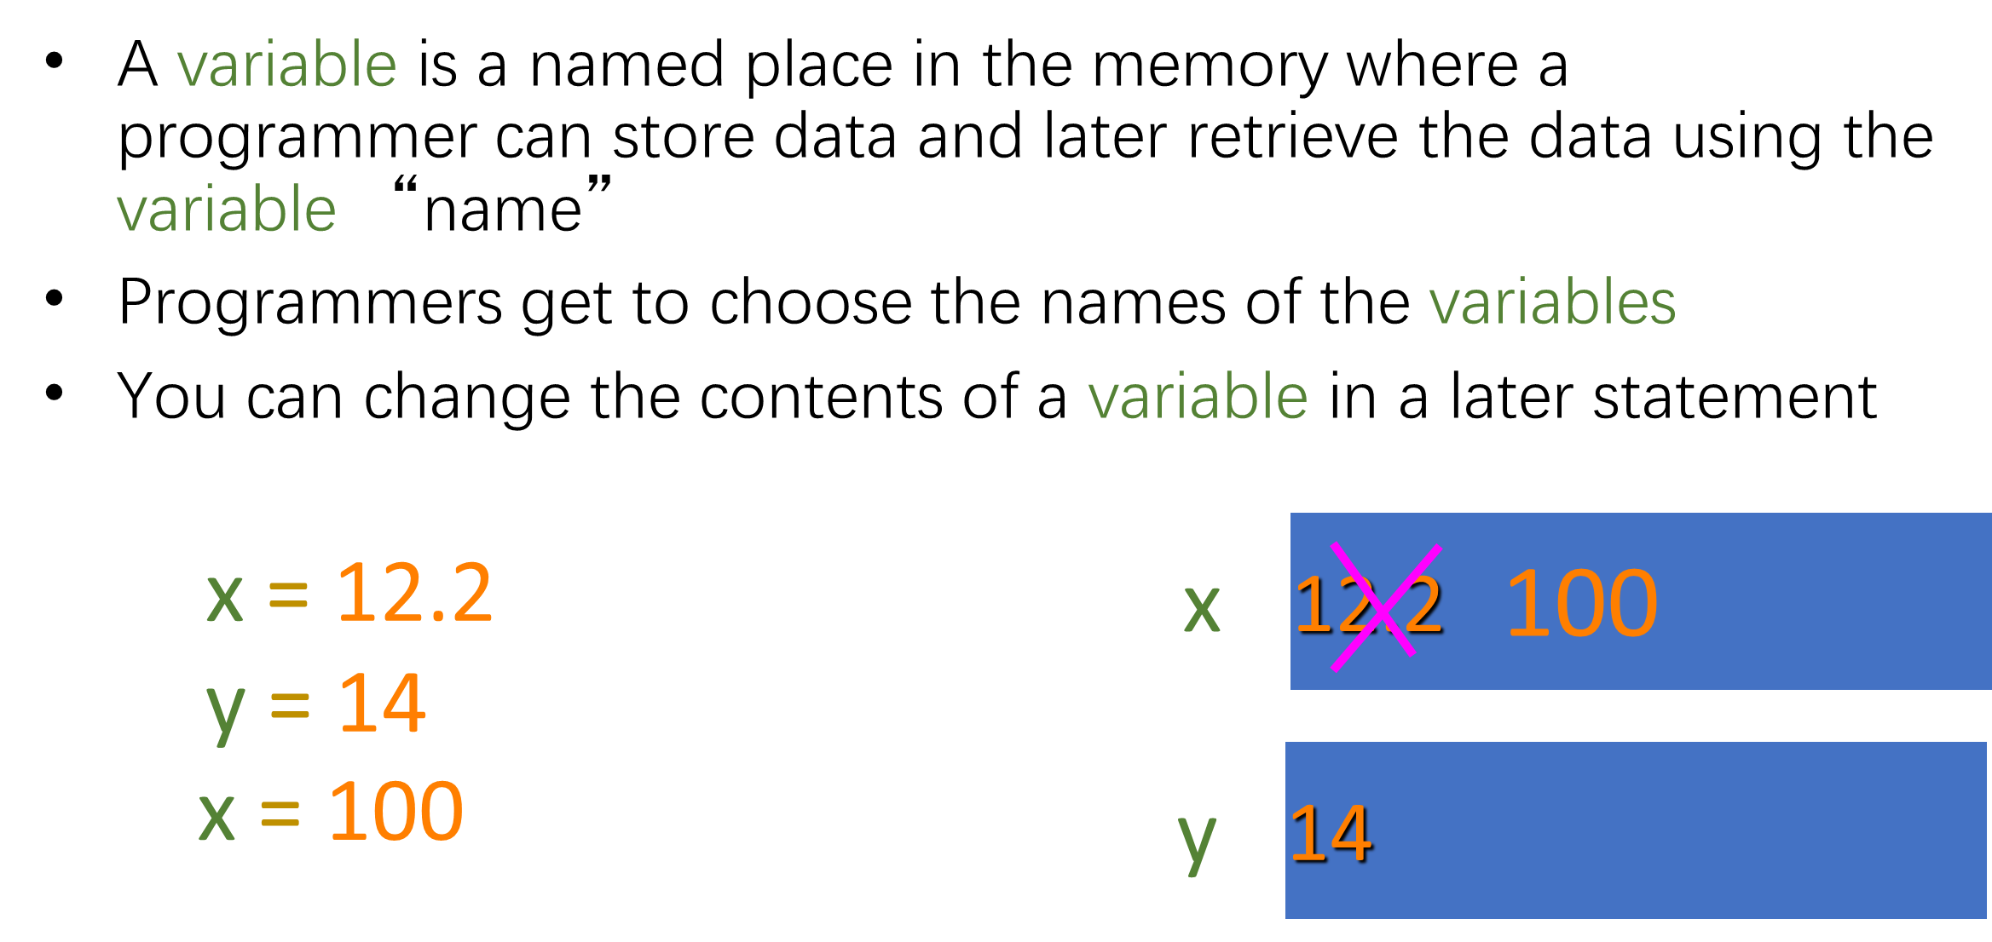
Variables

Slide 4
Python Variable Name Rules
Must start with a letter or underscore _
Must consist of letters and numbers and underscores
Case Sensitive
Good: spam eggs spam23 _speed
Bad: 23spam #sign var.12
Different: spam Spam SPAM

Slide 5
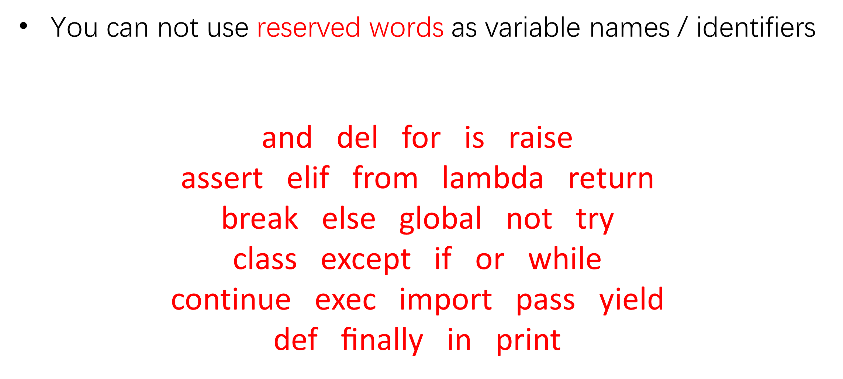
Reserved Words

Slide 6
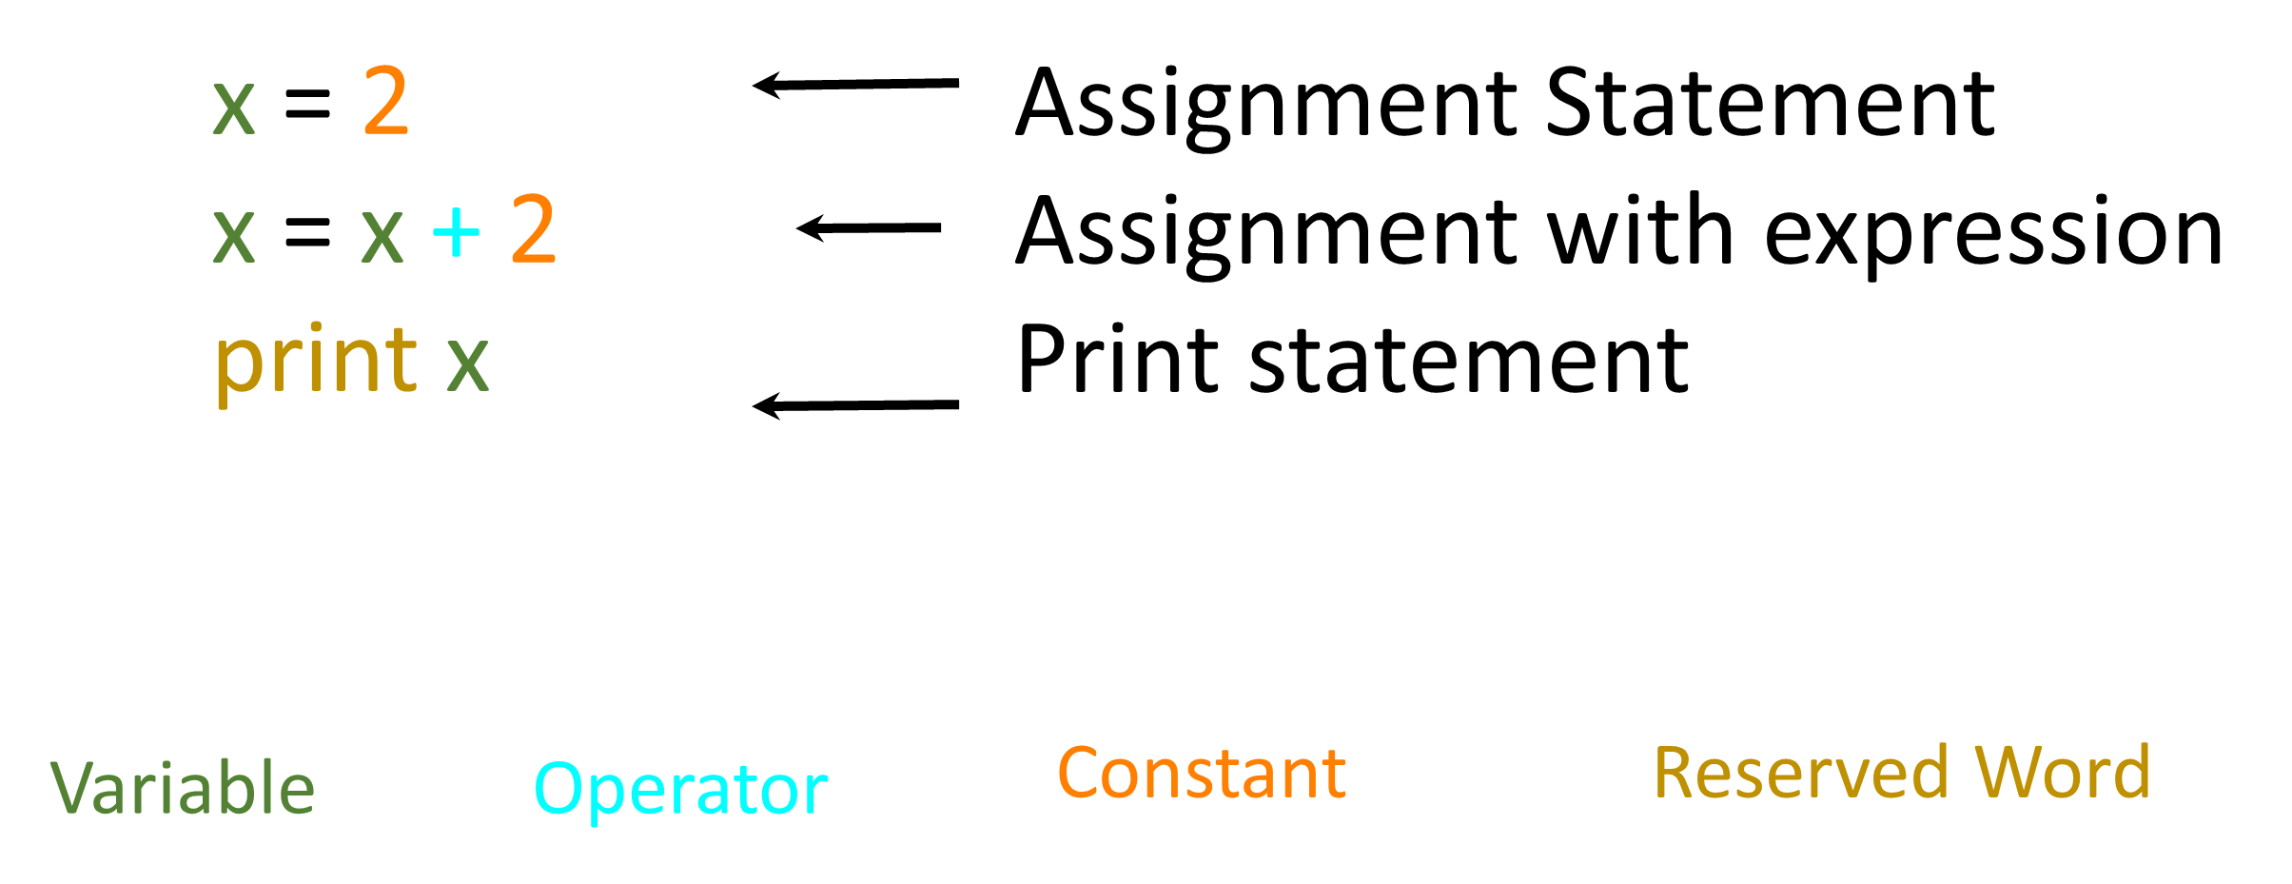
Sentences or Lines

Slide 7
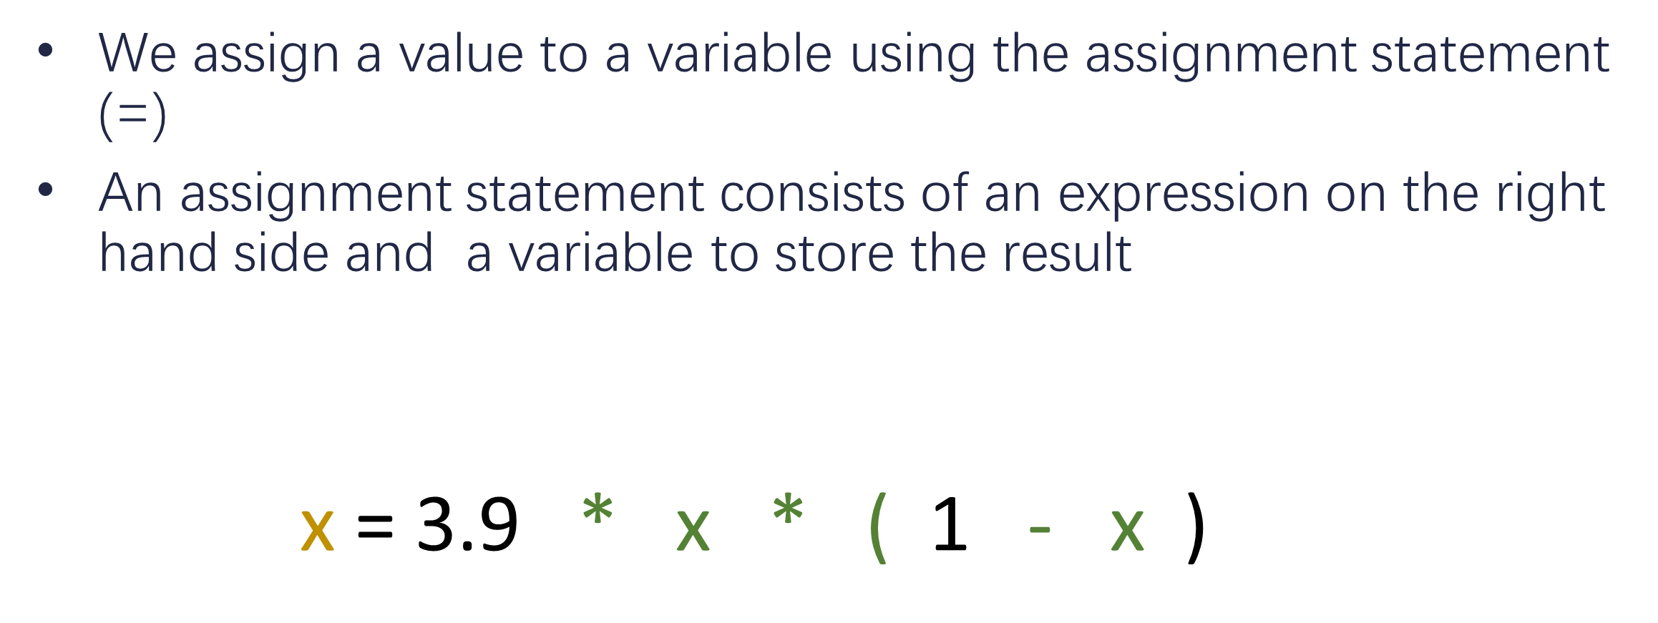
Assignment Statements

Slide 8
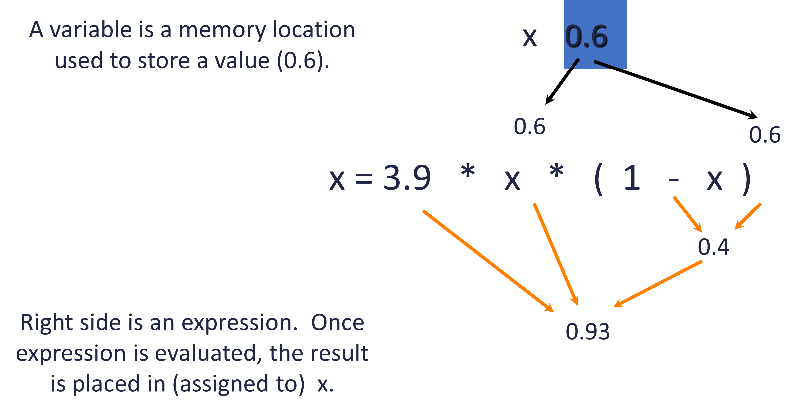

Slide 9
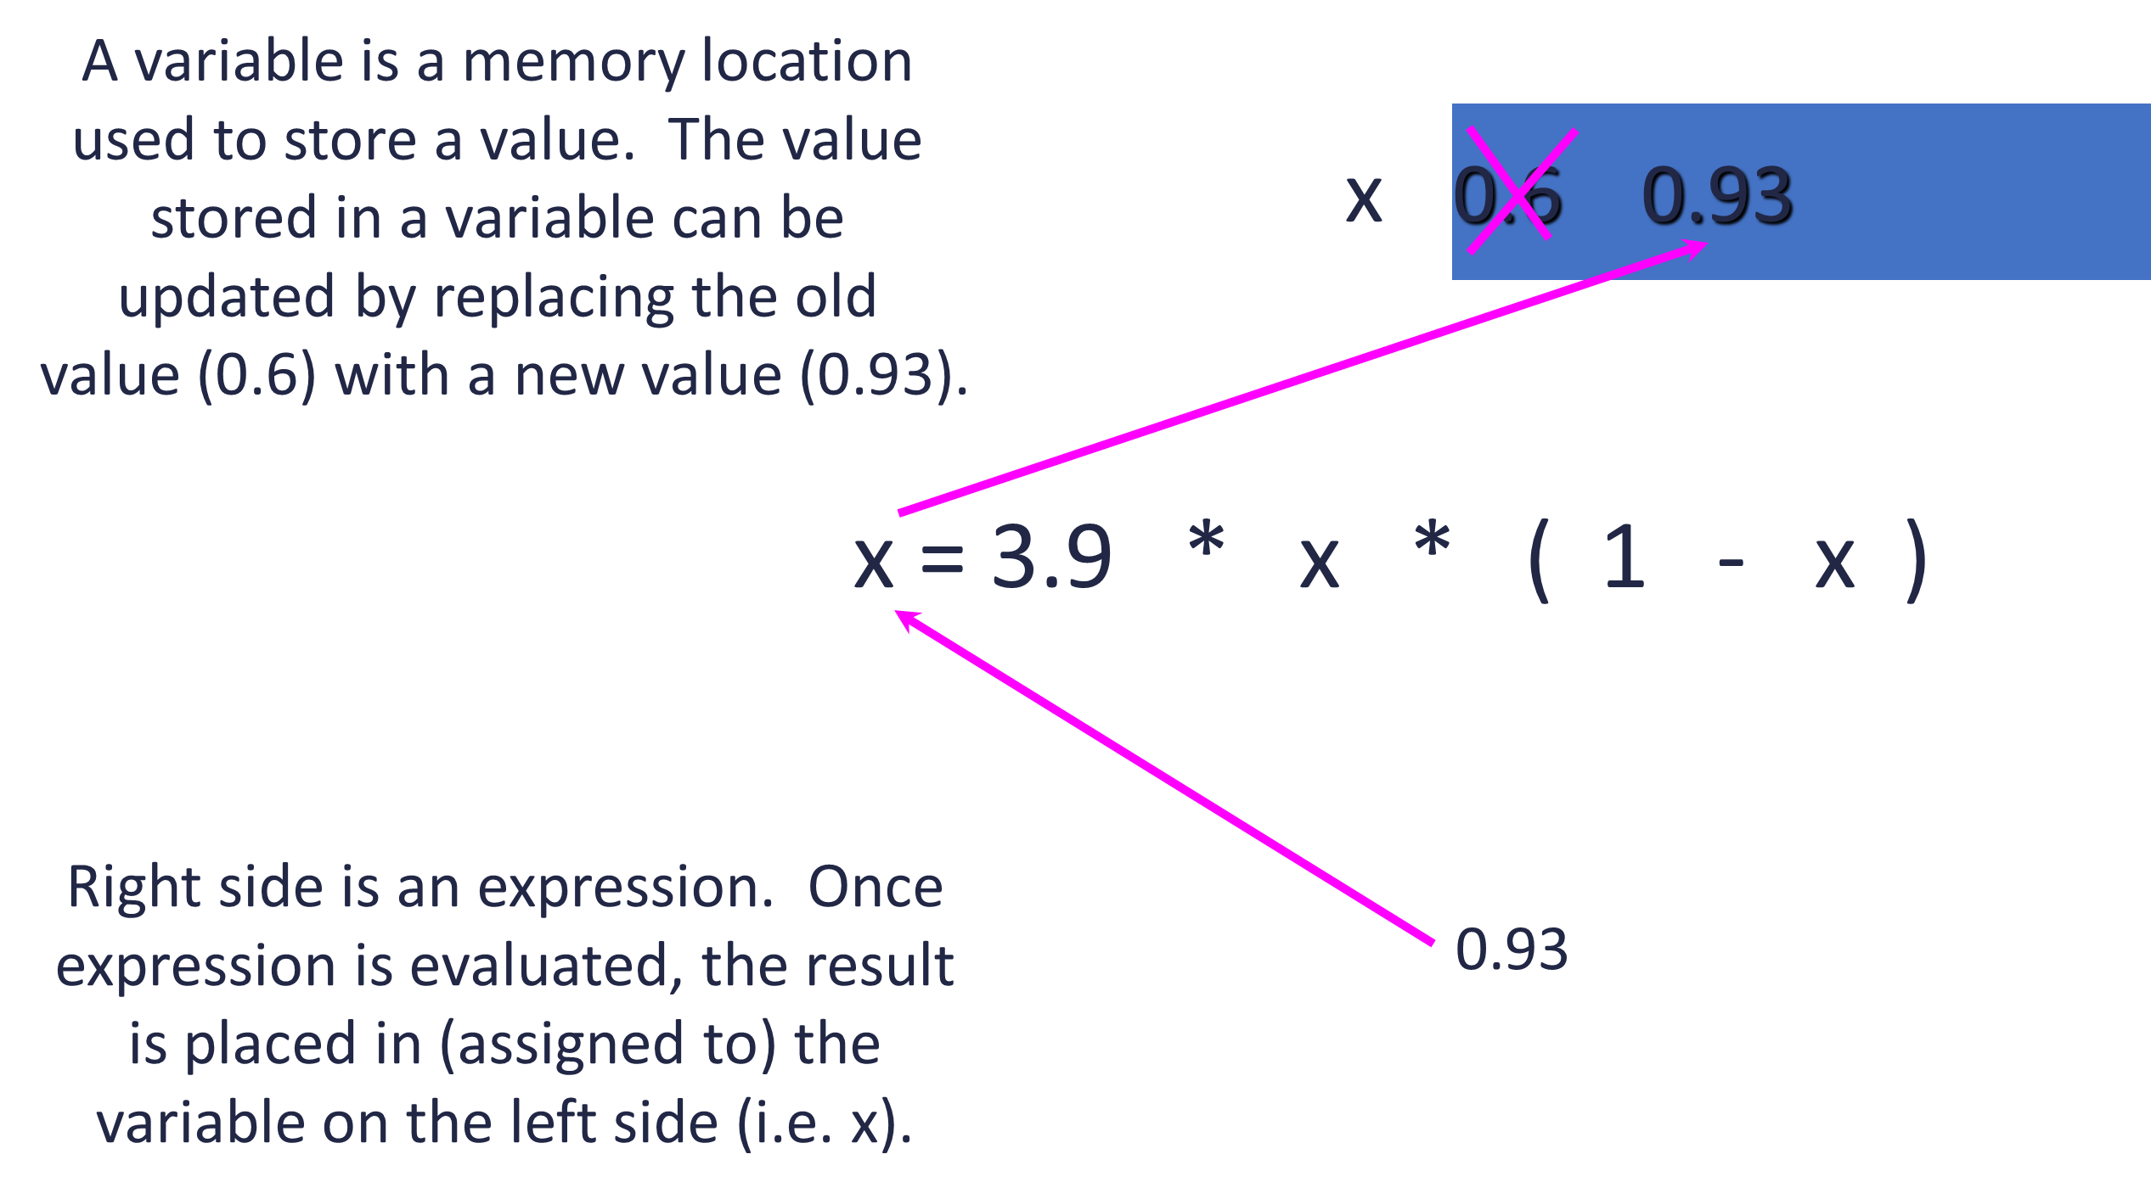

Slide 10
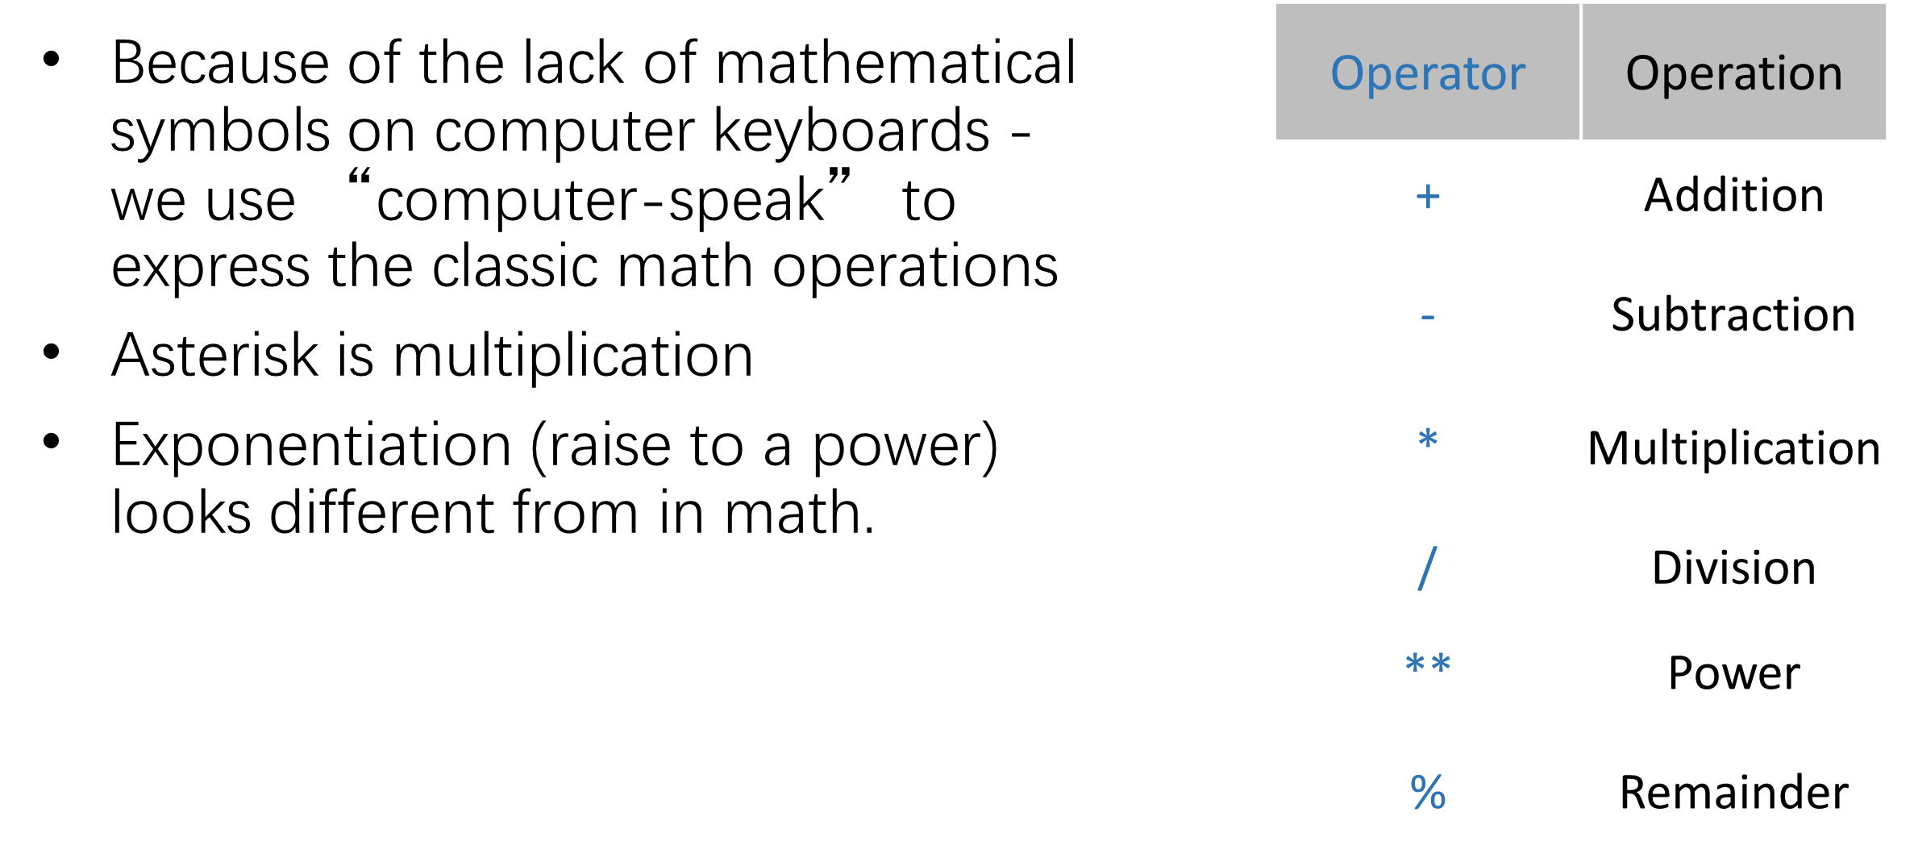

Slide 11
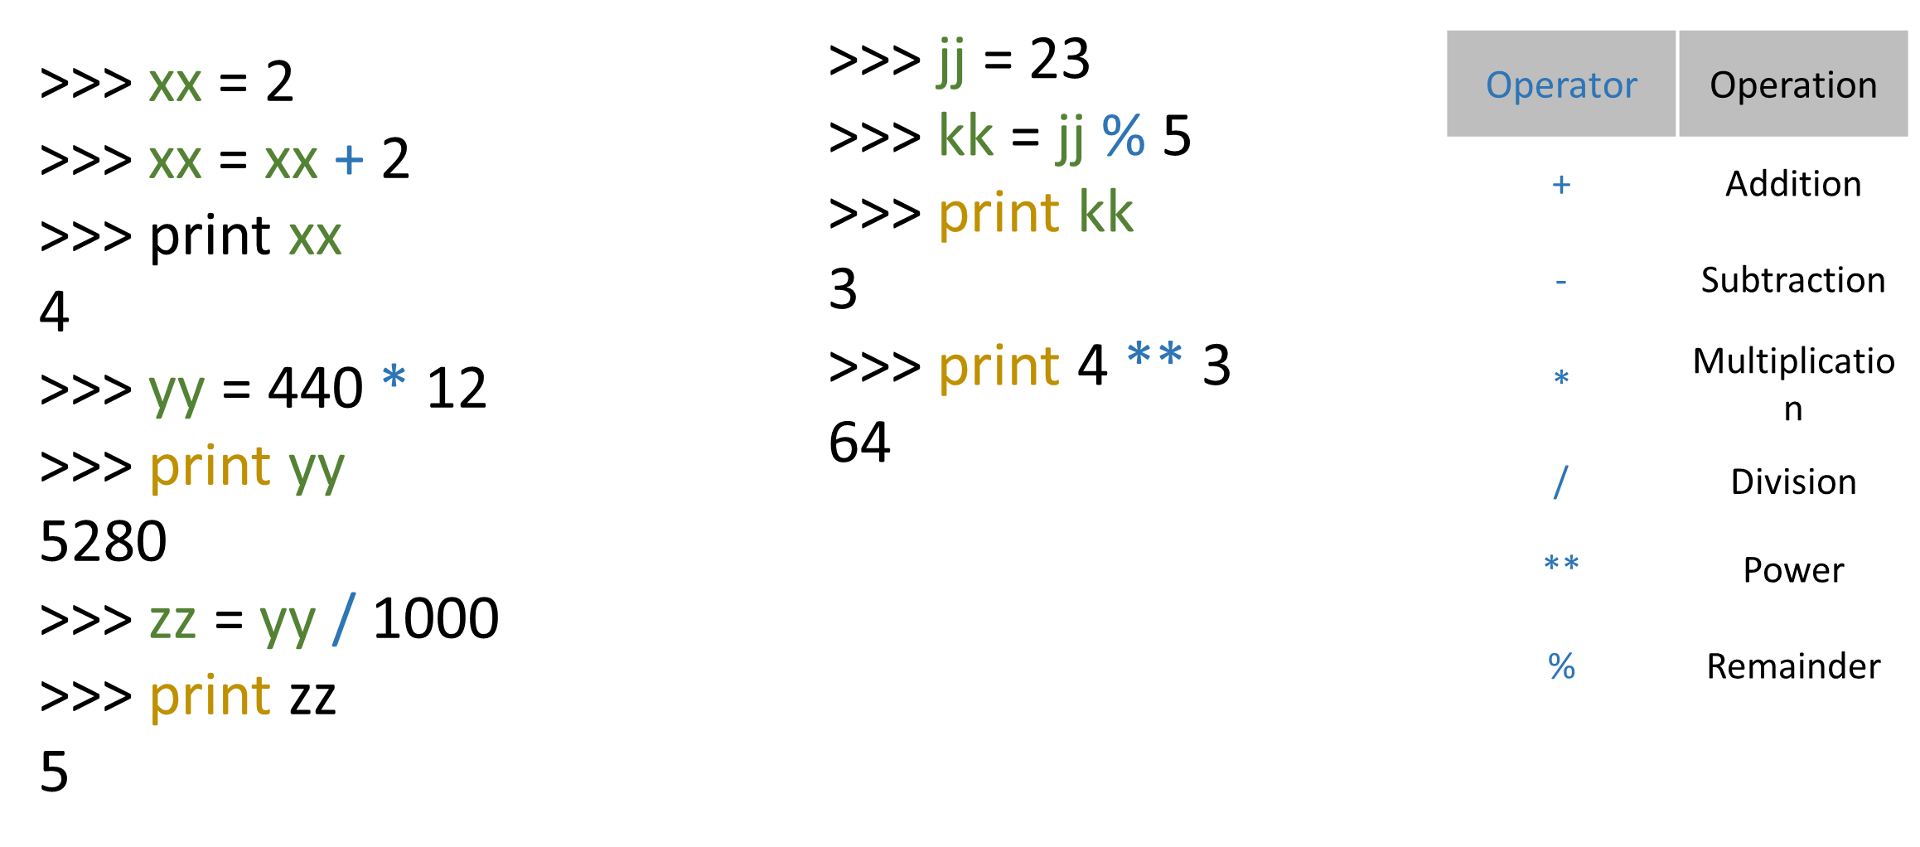
Numeric Expressions

Slide 12
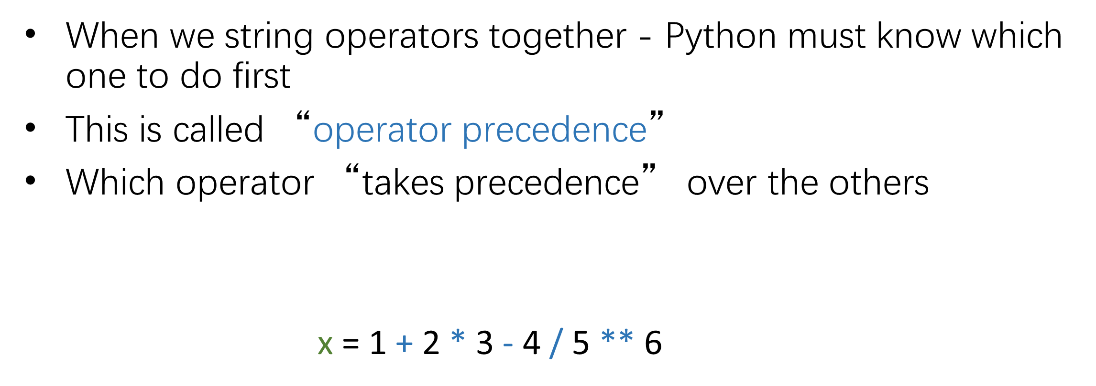
Order of Evaluation

Slide 13
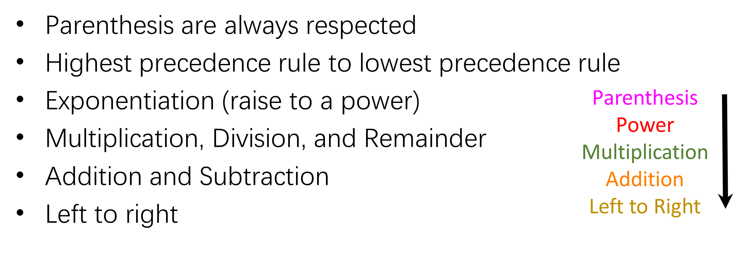
Operator Precedence Rules

Slide 14
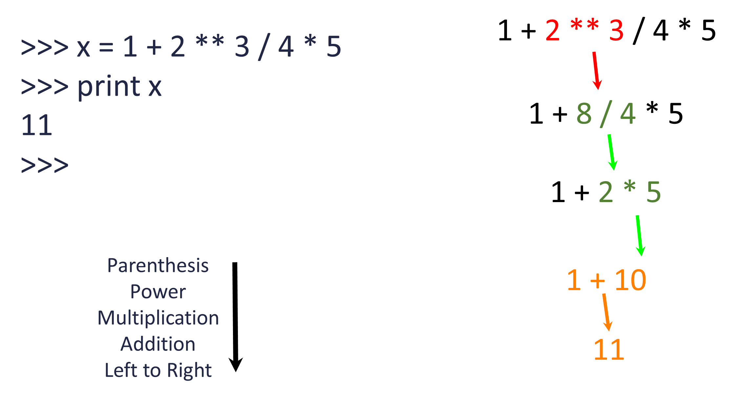

Slide 15
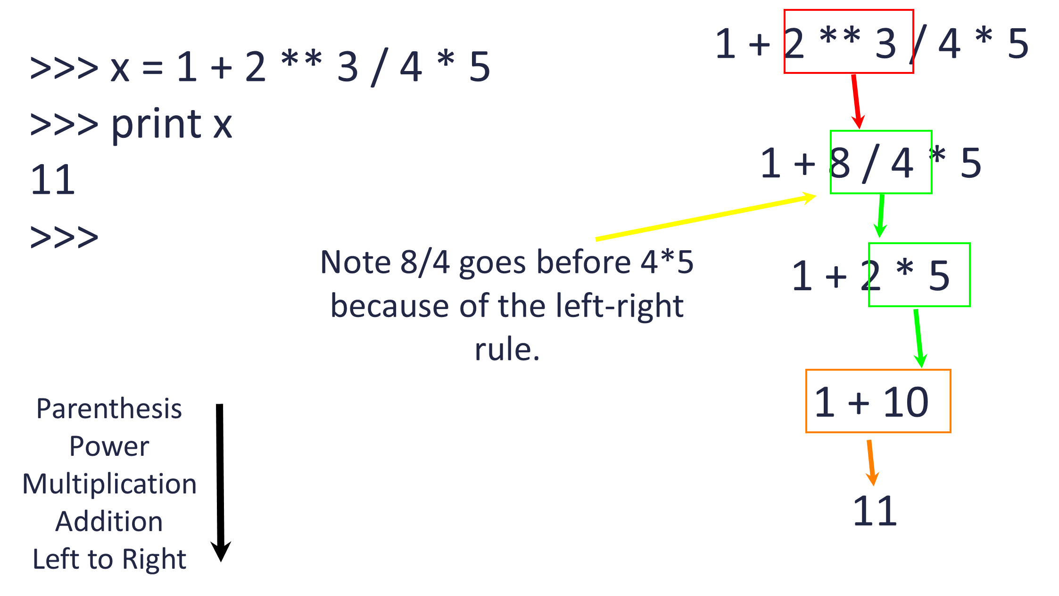

Slide 16
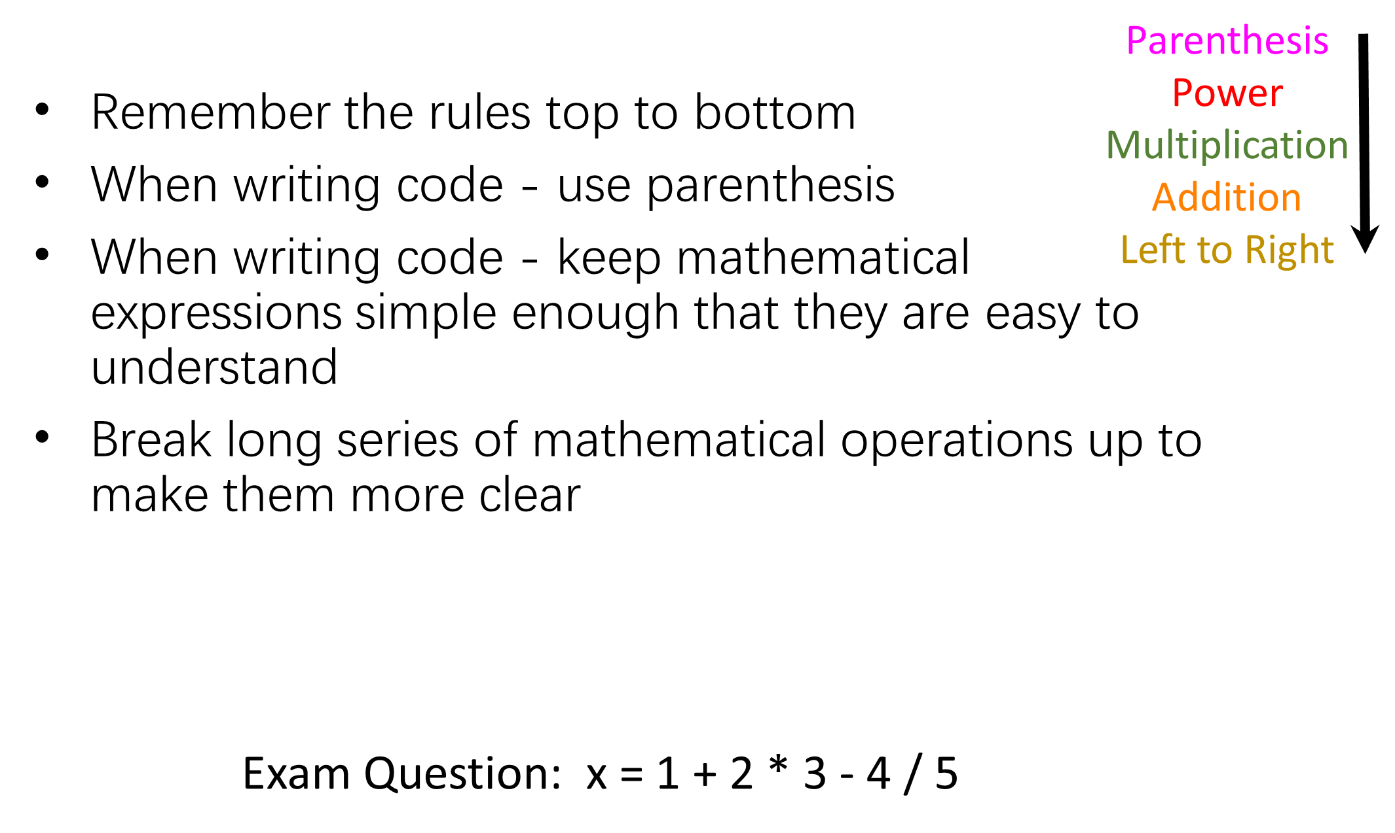

Slide 17
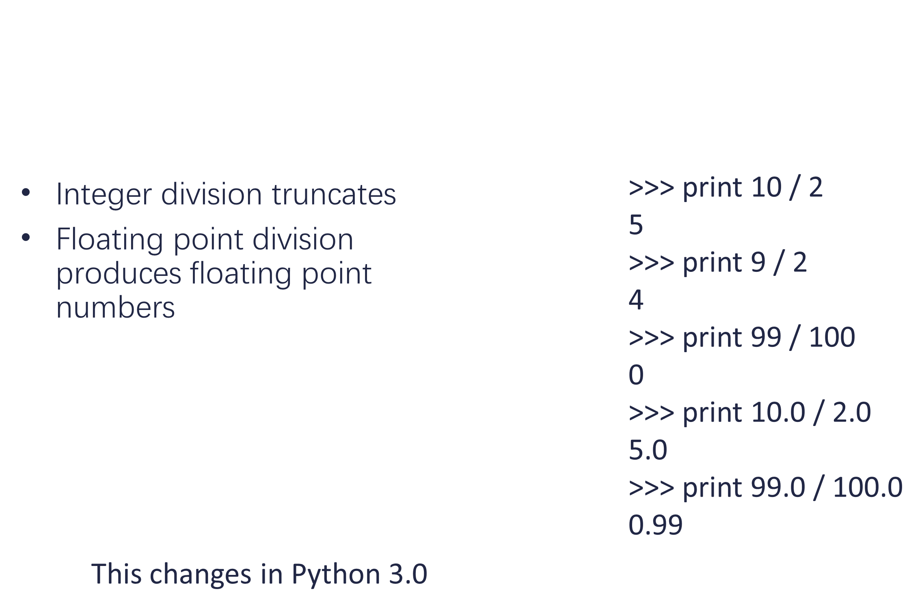

Slide 18
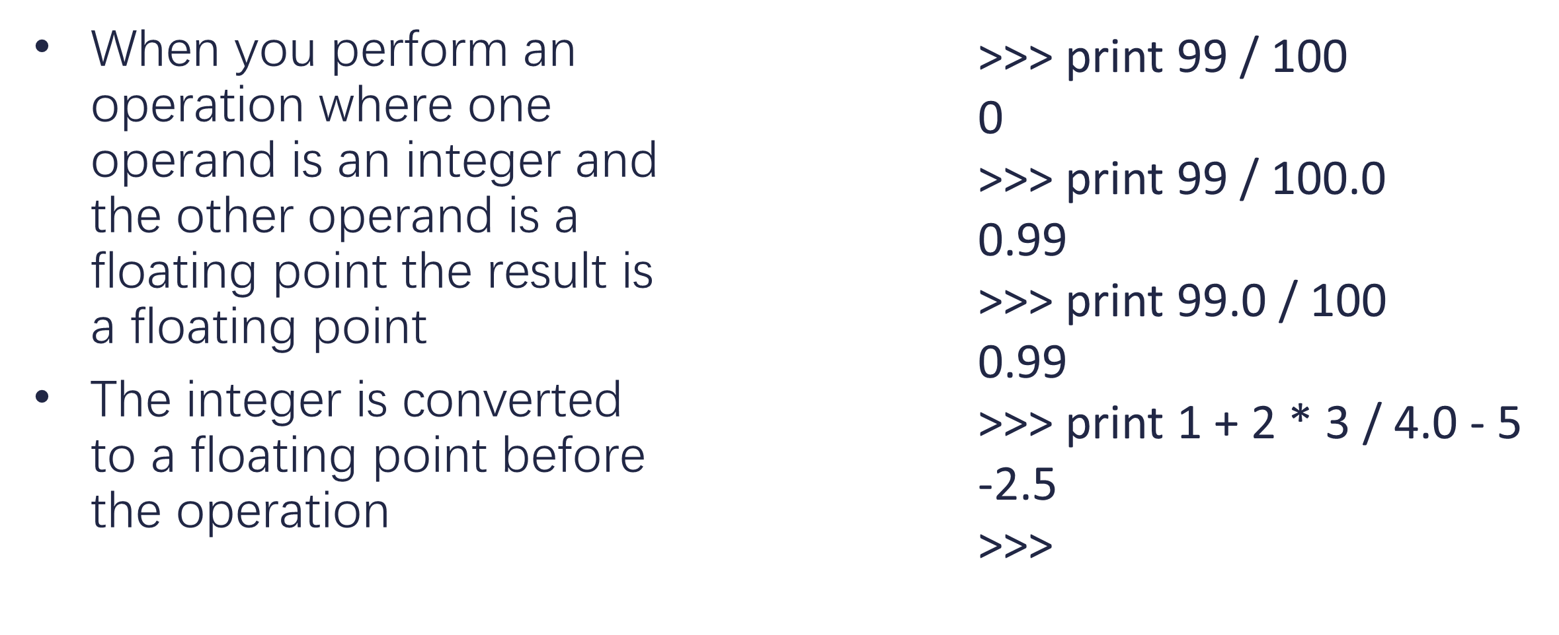
Mixing Integer and Floating

Slide 19
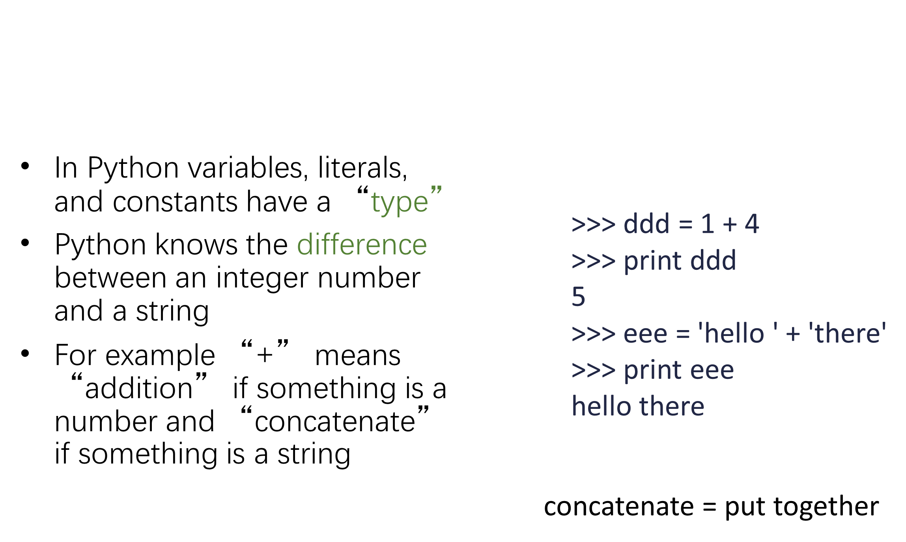
What does “Type” Mean?

Slide 20
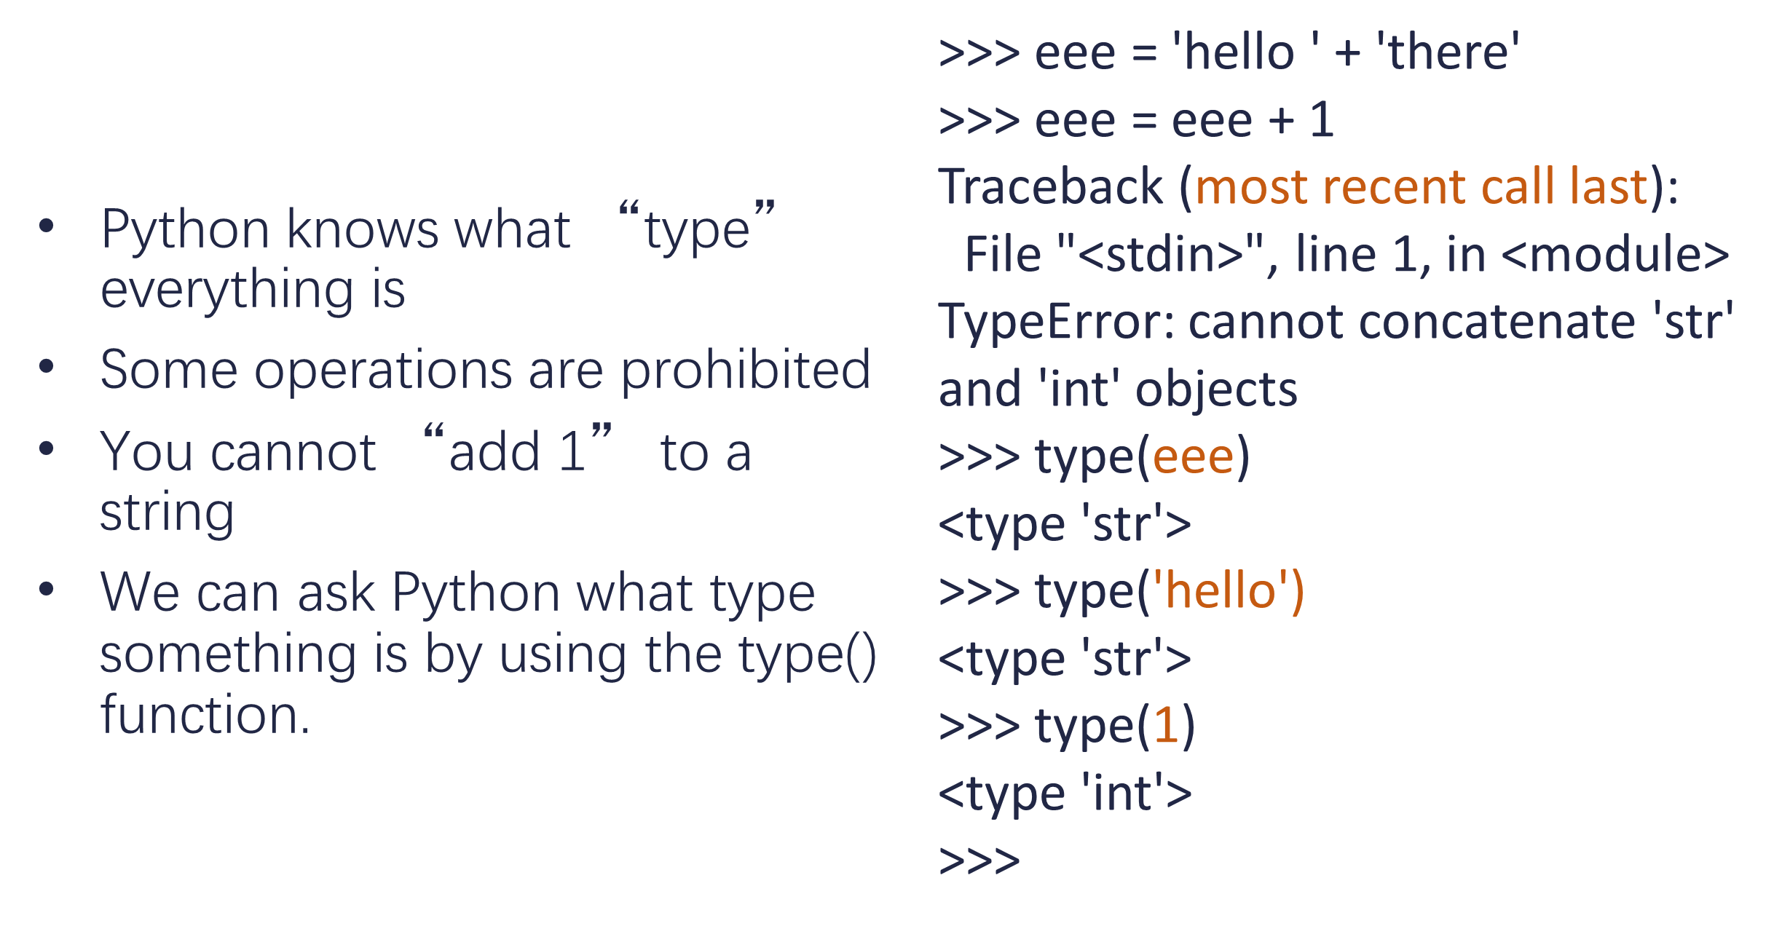
Type Matters

Slide 21
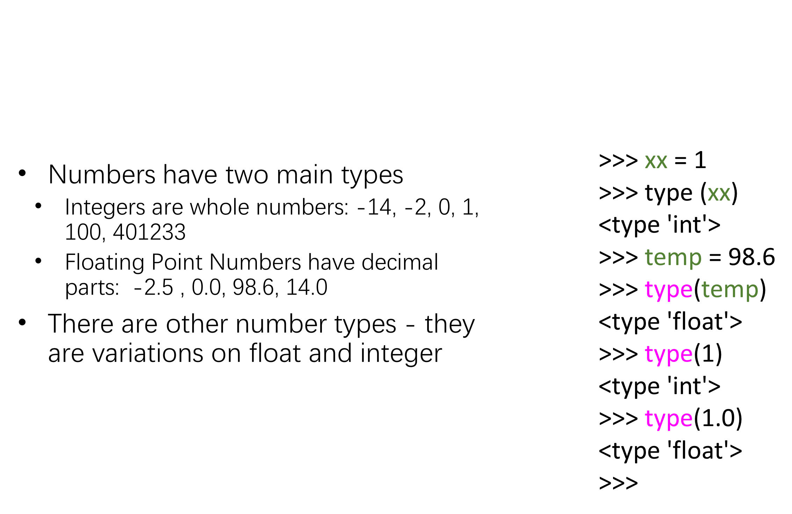
Several Types of Numbers

Slide 22
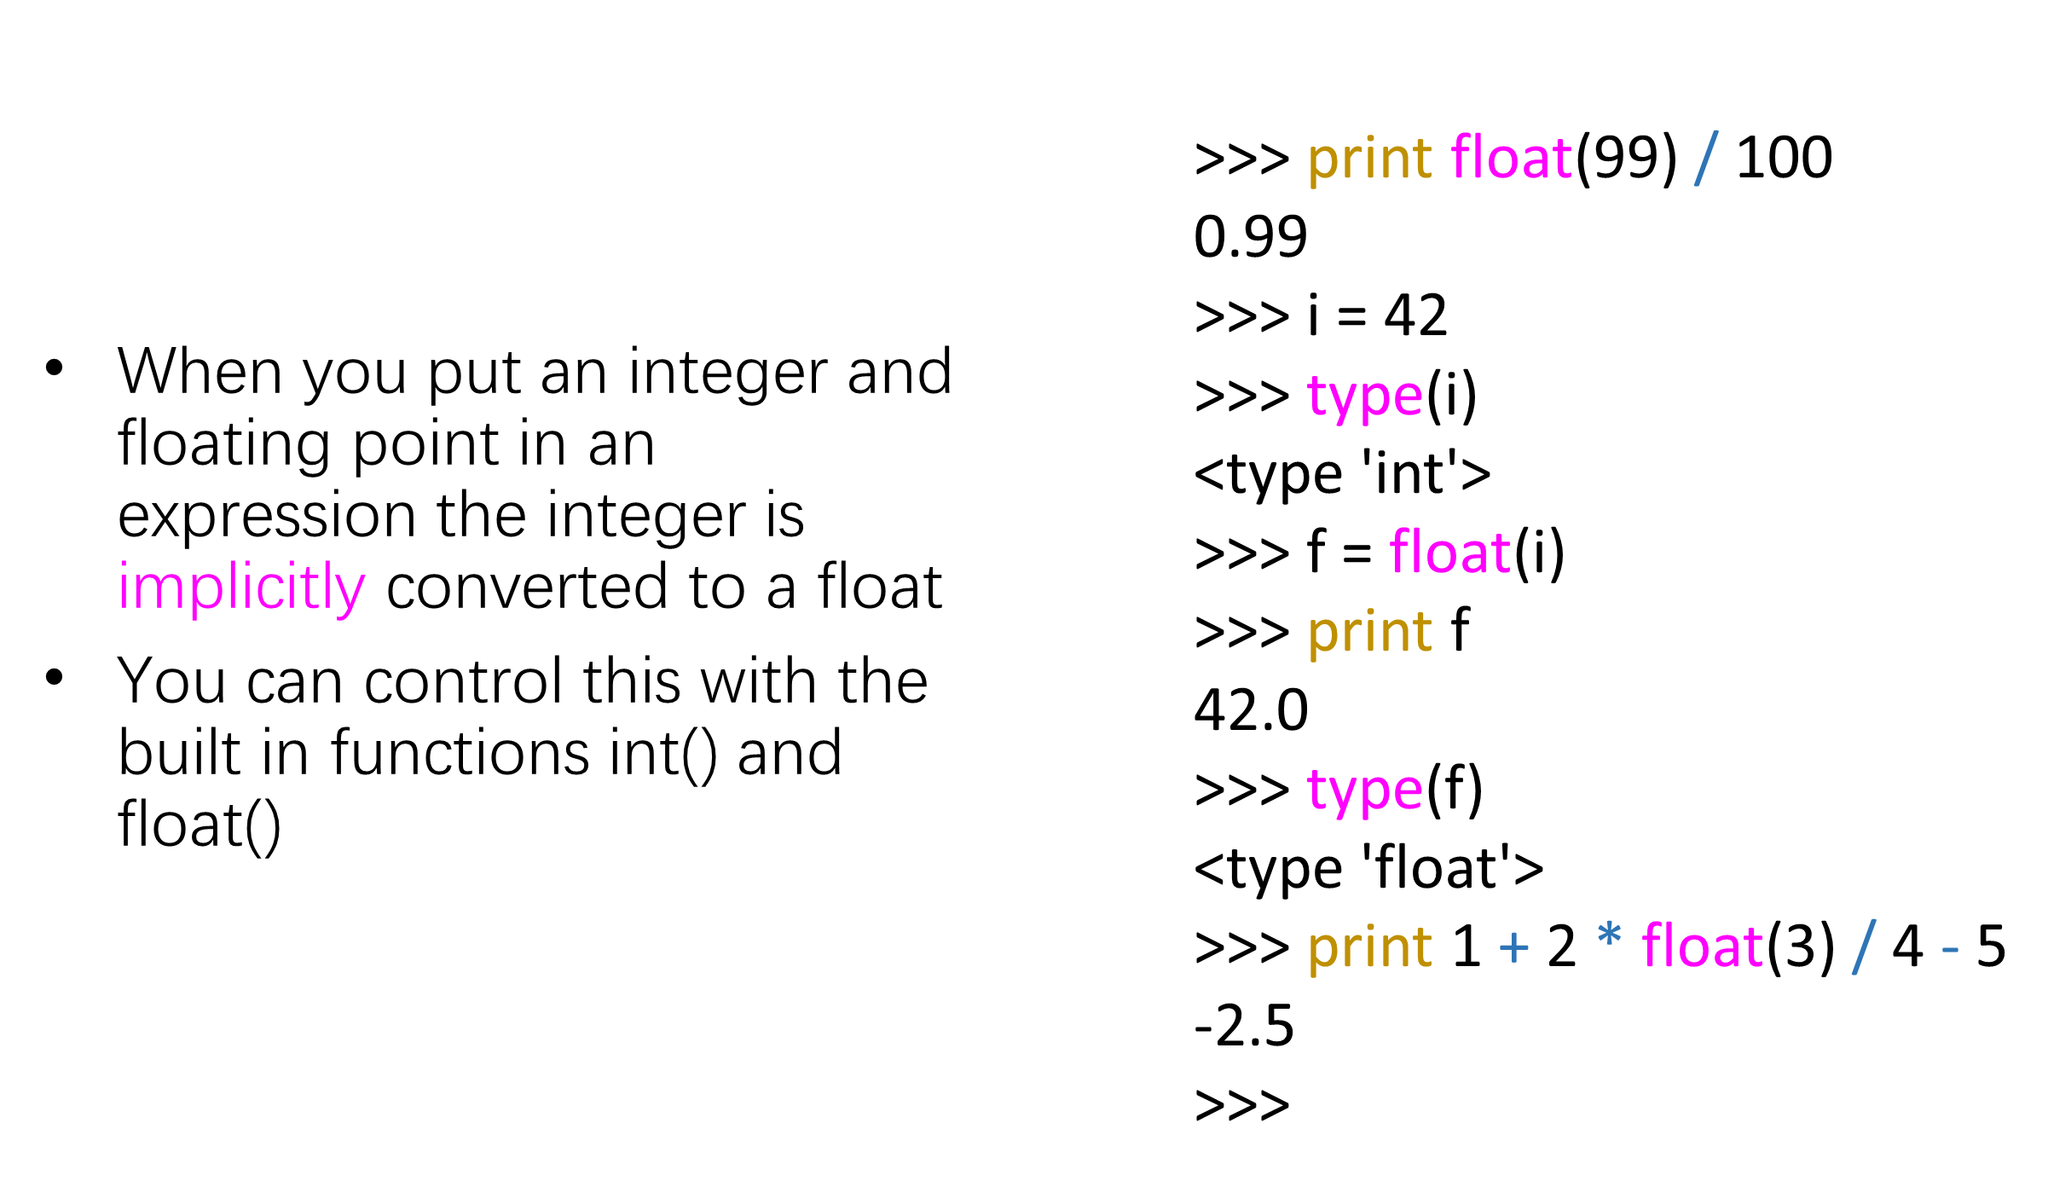
Type Conversions

Slide 23
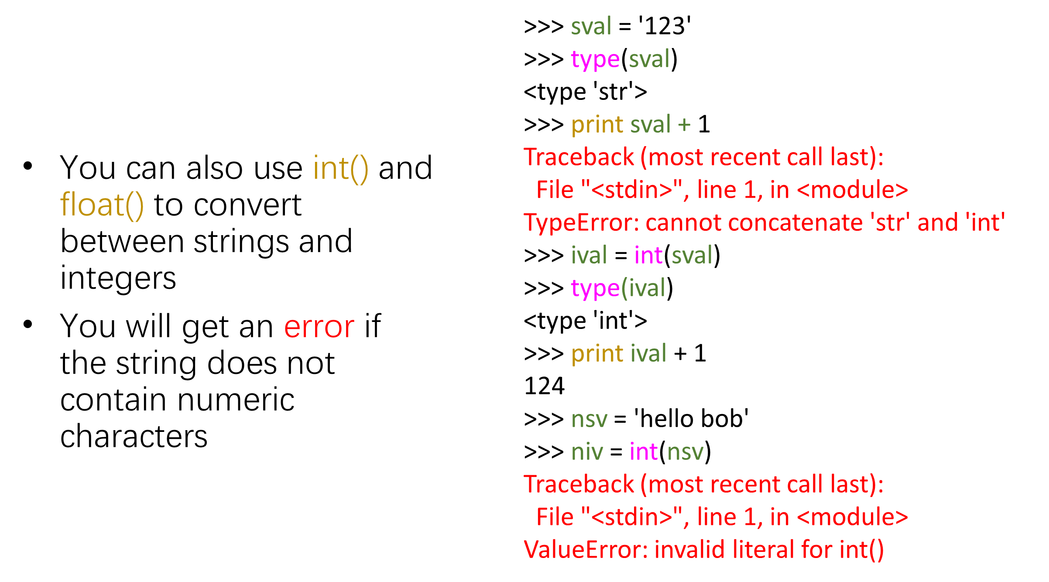
String Conversions

Slide 24
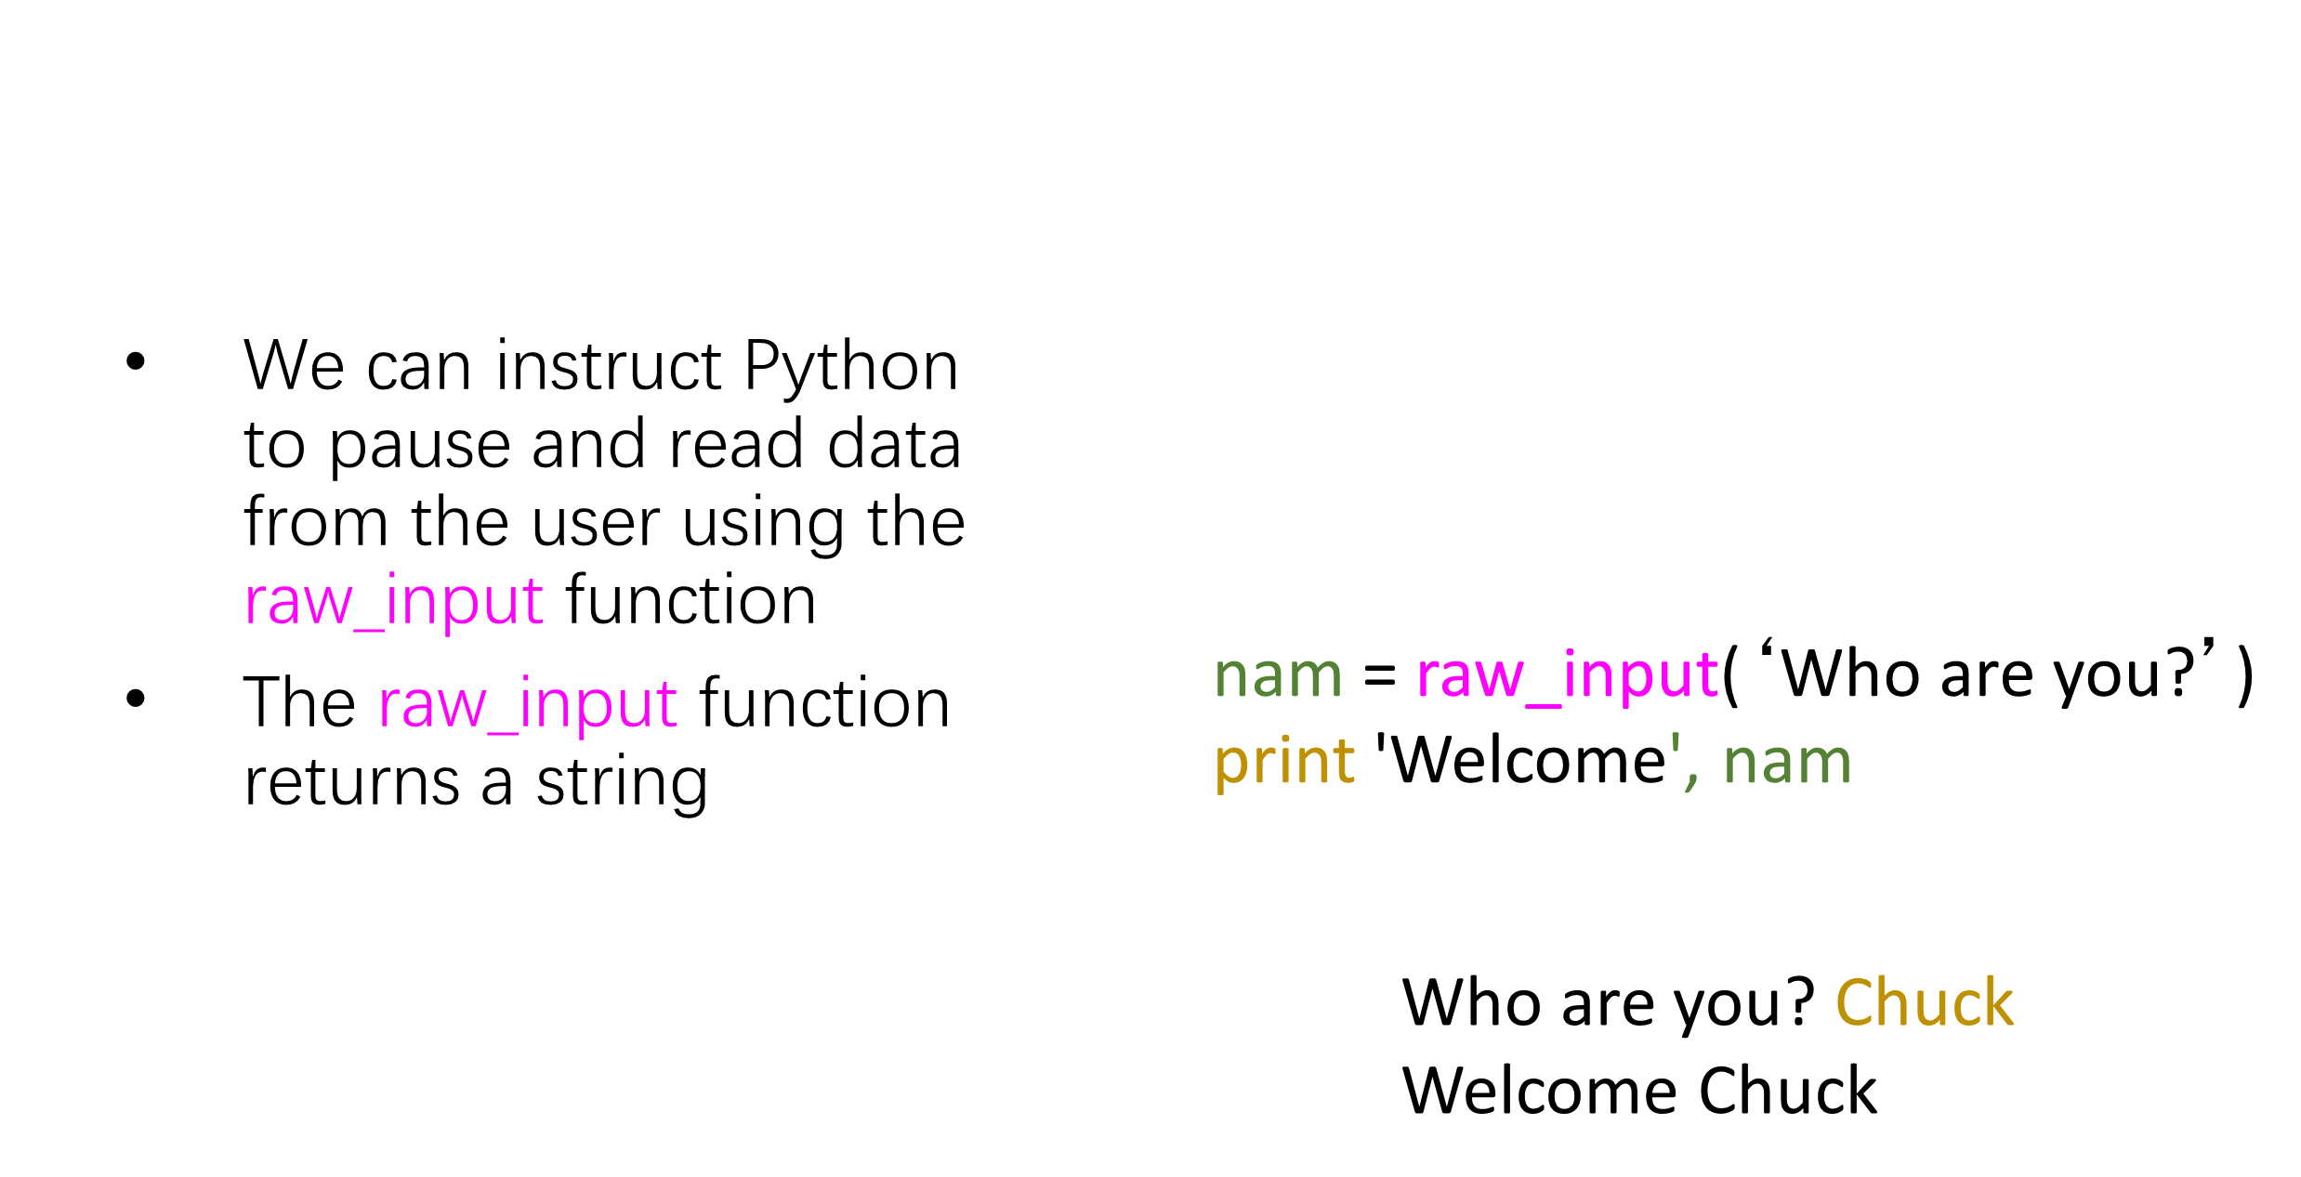
User Input

Slide 25
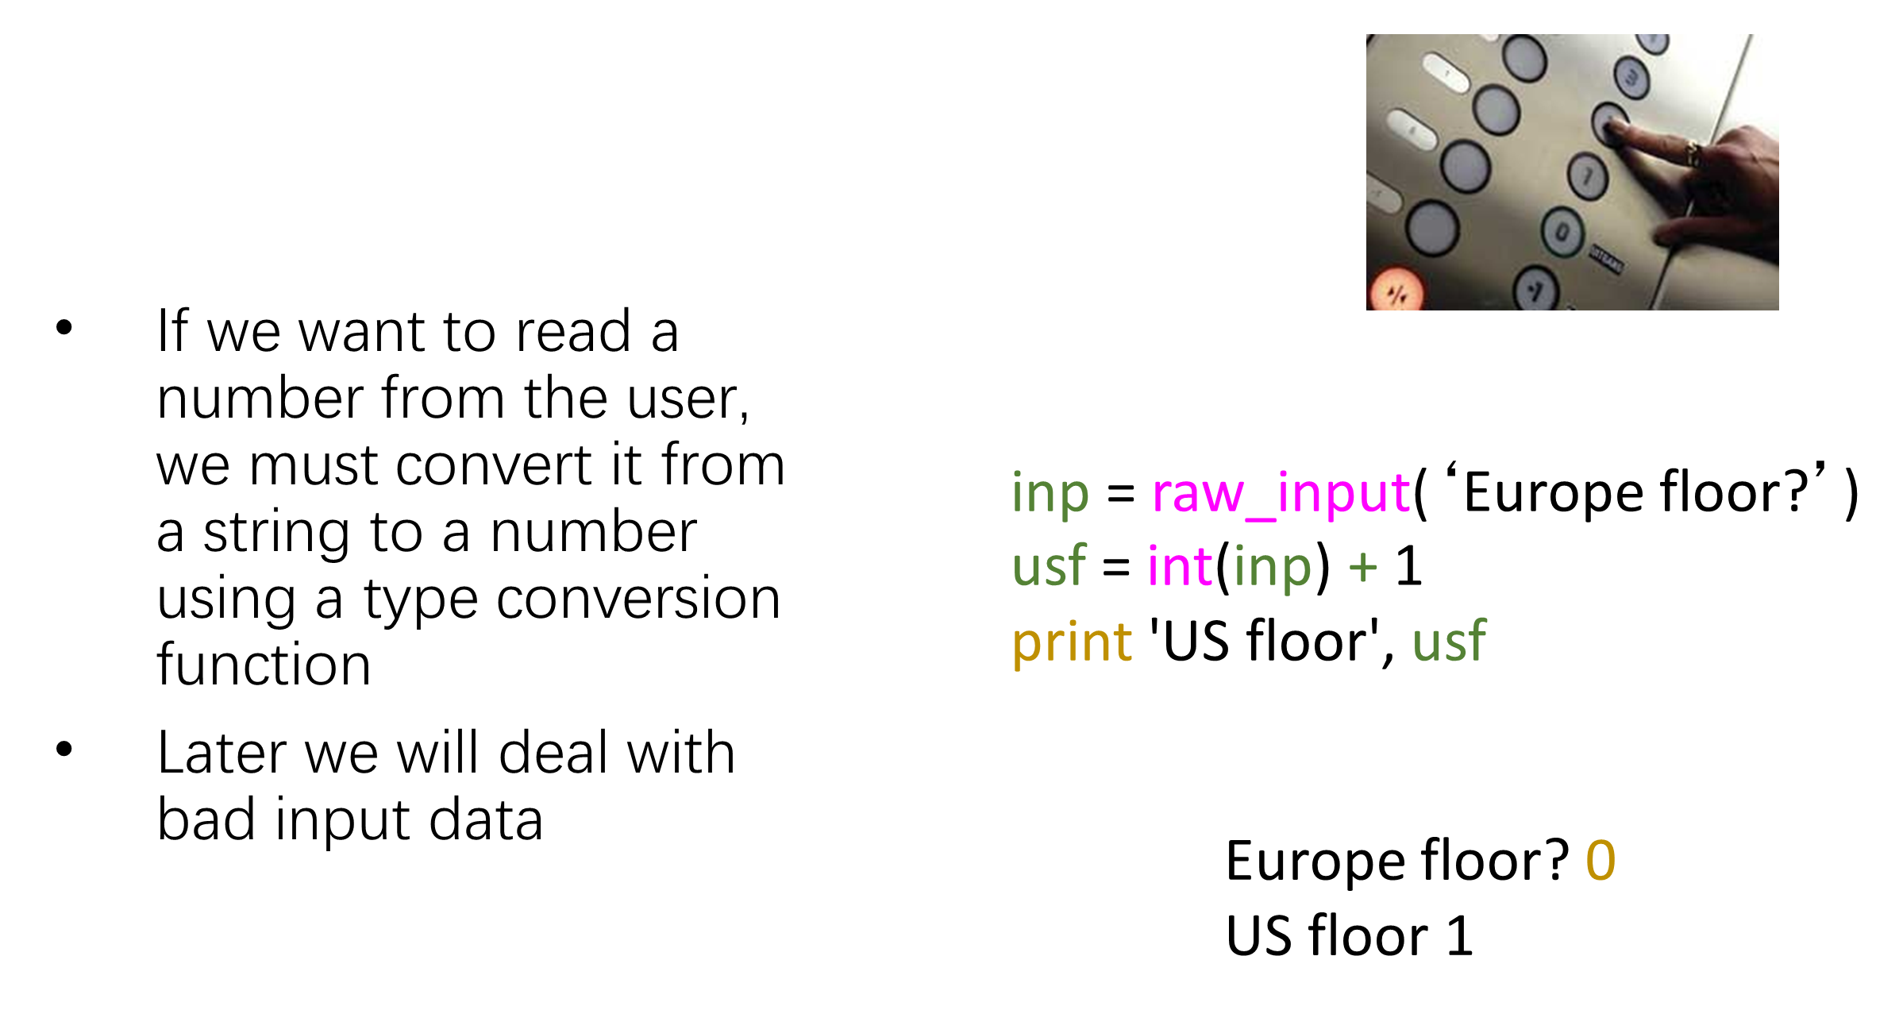
Converting User Input

Slide 26
Anything after a # is ignored by Python
Why comment?
Describe what is going to happen in a sequence of code
Document who wrote the code or other ancillary information
Turn off a line of code - perhaps temporarily

Slide 27
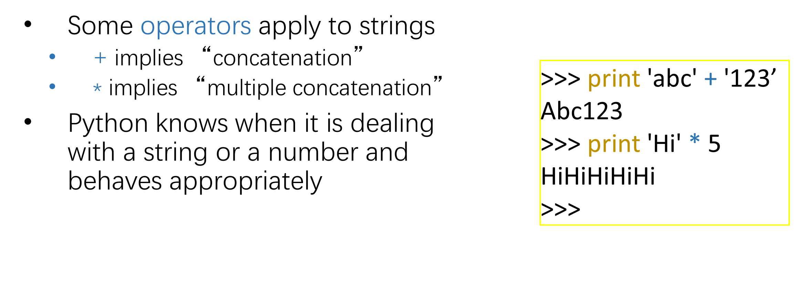
String Operations

Slide 28
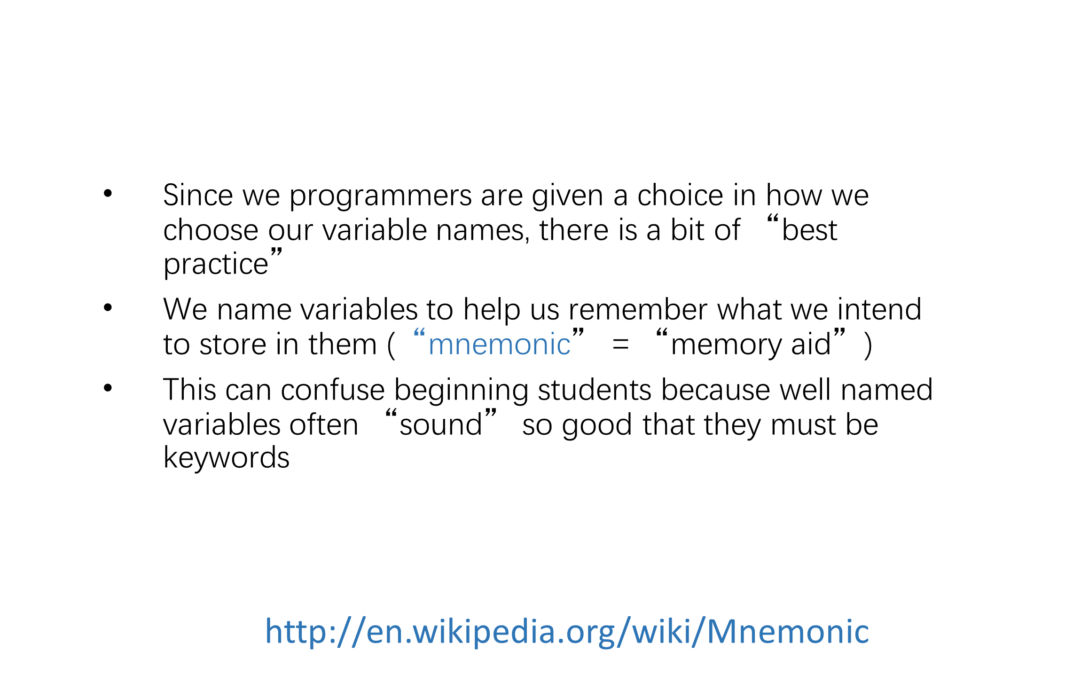
Mnemonic Variable Names

Slide 29
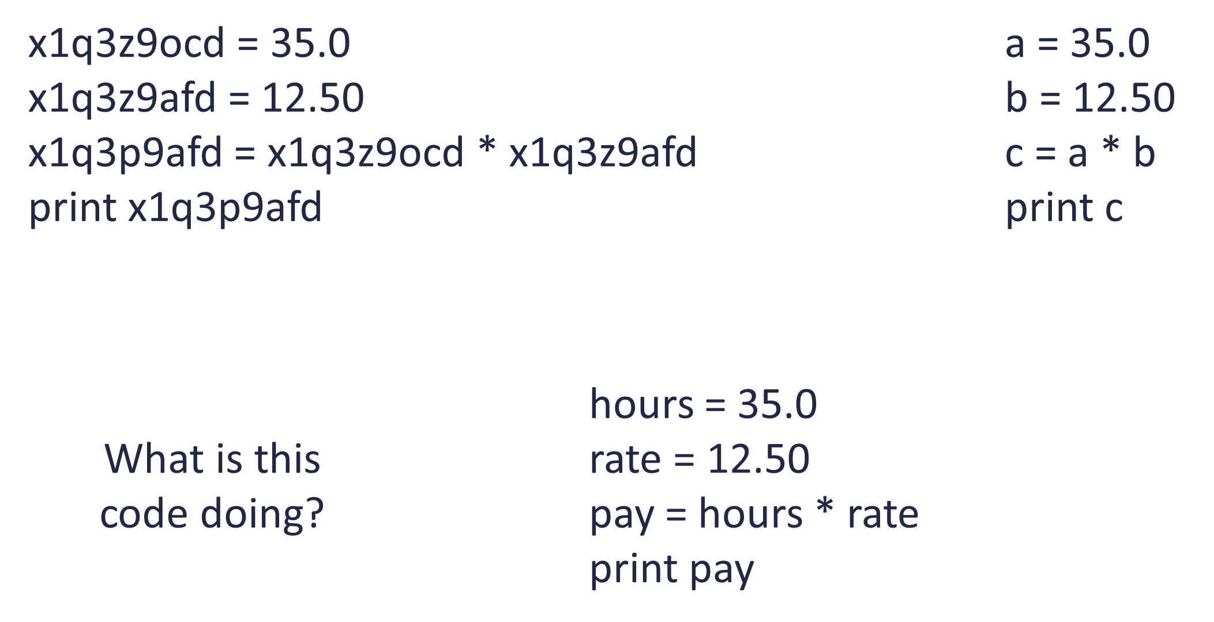

Slide 30
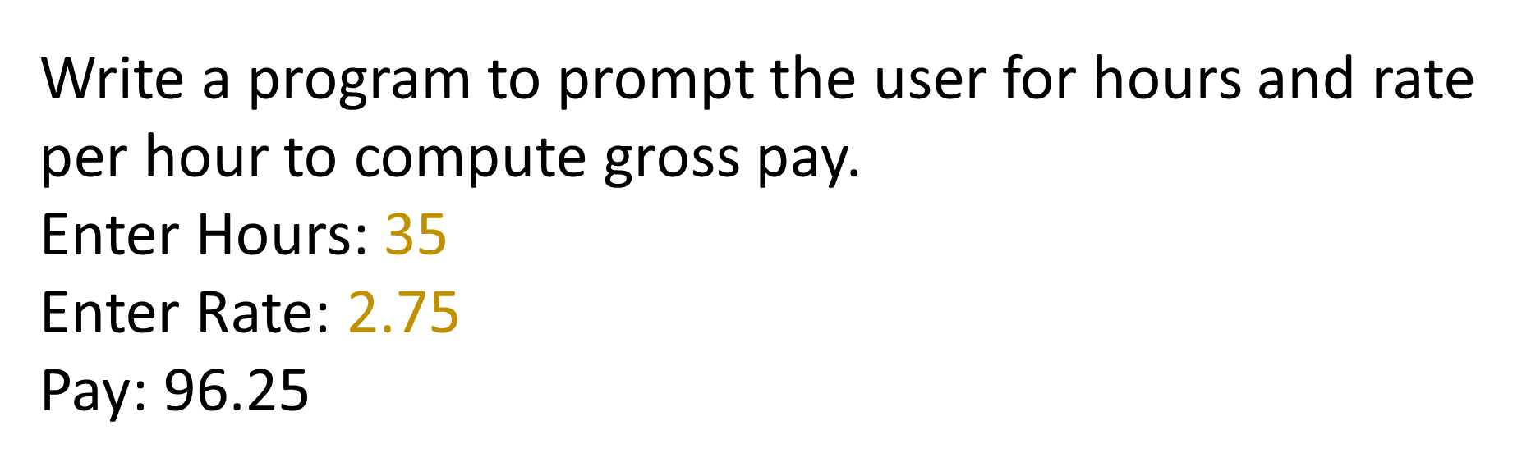
Exercise

Slide 31
Summary
Type
Reserved words
Variables (mnemonic)
Operators
Operator precedence
Integer Division
Conversion between types
User input
Comments (#)

Slide 32
Thank You

